Slide 1

Prepared by: Abdulrahman, Nasser
Classifying urban sounds
Deep Learning

Slide 2
Outline
01
Introduction
Problem Statement
Data Description
Visual inspection
Models
Future work
Conclusion
02
03
04
05
06
07

Slide 3
Introduction
Sounds are all around us.
Whether directly or indirectly we are always in contact with audio data.
Sounds outline the context of our daily activities.

Slide 4
Problem Statement
Assisting deaf individuals
Smart home
Automotive
The main objective of this project will be to use Deep Learning techniques to classify urban sounds

Slide 5
Data Description
The dataset contains 8732 and 8 features :
slice _ file _ name , fsID, start , end , salience , fold , classID , class_name
sound excerpts (<=4s) of urban sounds from 10 classes, which are:
- Air Conditioner
- Car Horn
- Children Playing
- Dog bark
- Drilling
- Engine Idling
- Gun Shot
- Jackhammer
- Siren
- Street Music
These sound excerpts are digital audio files in .wav format.

Slide 6
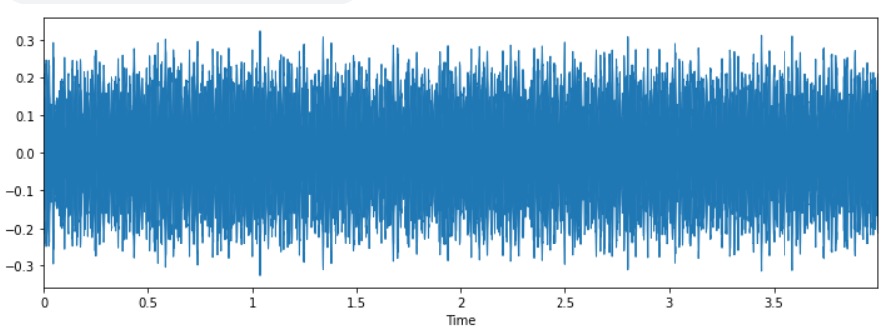
Visual inspection
Engine Idling

Slide 7
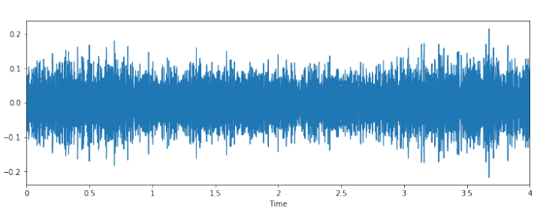
Visual inspection
Siren

Slide 8
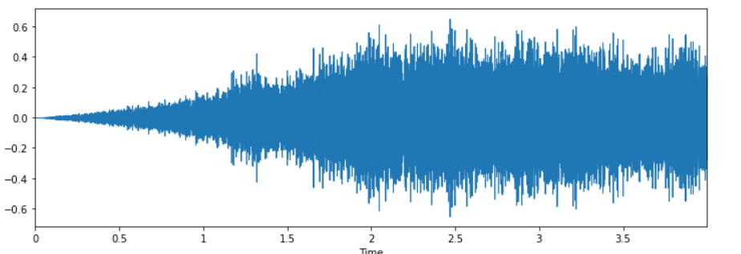
Visual inspection
Drilling

Slide 9
(MLP) Neural Network
Training Accuracy= 0.925
Testing Accuracy=0.876

Slide 10
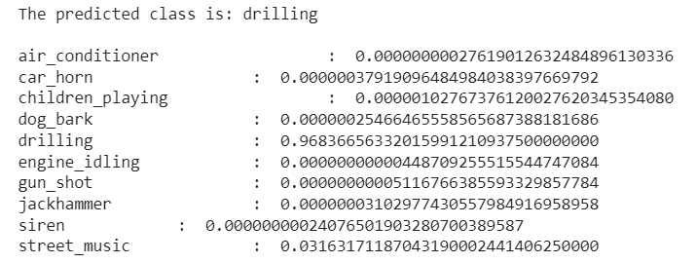
Predictions
Drilling

Slide 11
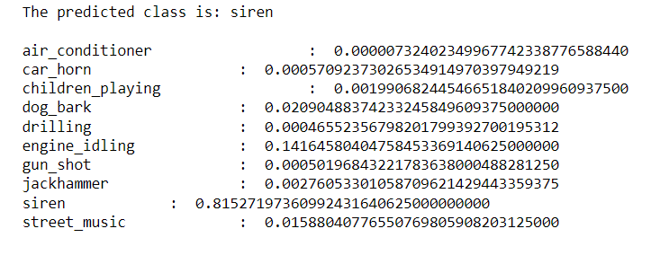
Predictions
Siren

Slide 12
(CNN) model
Training Accuracy= 0.98
Testing Accuracy=0.91

Slide 13
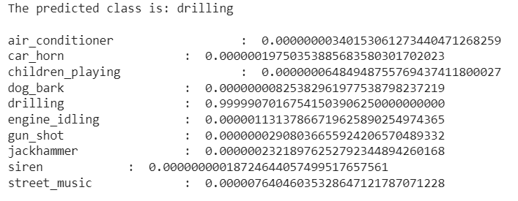
Predictions
Drilling

Slide 14
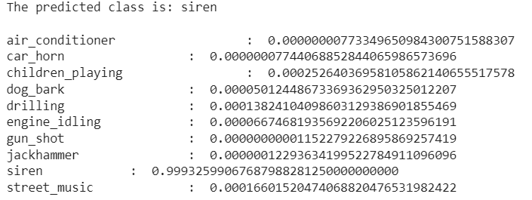
Predictions
Siren

Slide 15

Future work

Slide 16
Conclusion
In our first attempt of the MLP model we were able to achieve the degree of classification accuracy of
Training Accuracy 92
Testing Accuracy 87
Whereas CNN was better in the degree of accuracy of voice classification
Training Accuracy 98
Testing Accuracy 92

Slide 17
Thank You

